Slide 1
A Vision for K-12 Science Education as Described in the Framework for K-12 Science Education and Next Generation Science Standards How is NGSS different than current standards and instructional practices? How can the NGSS and vision for science education better prepare students to become the innovators, problem solvers, and thinkers in the future? Thursday, August 28, 2014
Presenter, Brett Moulding,
Partnership for Effective Science Teaching and Learning

Slide 2
Overview
NRC Framework for K-12 Science Education
A Vision for Science Education
Student Science Performances at the Intersection of the Three Dimensions
NGSS
Changes
Closure and Discussion

Slide 3
A Vision for Science Teaching and Learning Built on Research
Notes:
The Framework provides a vision for science education in this nation. The vision include a set of standards that are student performance expectations.

Slide 4
Builds upon the Research on Learning the Ideas of Science
Notes:
The NRC studies and reports that lead up to the Framework provide a foundation for the direction the Framework recommends for science education and science standards. Each has made a critical, often ground breaking contribution to our collective understanding of learning in the context of science. The Framework for K-12 Science Education that we are discussing with you today is constructed around many of the research-based ideas on learning, science, teaching, and cognitive development found in these reports. The Framework is based on a well-respected corpus of evidence.

Slide 5
Science for All Americans
NSES and
Benchmarks
Research (i.e. Taking Science to School and Ready, Set, Science!)
Framework for K-12 Science Education
NGSS
Progression
Notes:
A natural progression has occurred that lead to the Framework and OSS. State standards in the past have risen on a similar trajectory.
Language in the Benchmarks appears in the OSS DCIs

Slide 6
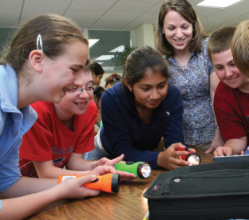
Goals for Science Education
The Framework’s vision takes into account two major goals for K-12 science education:
Educating all students in science and engineering.
Providing the foundational knowledge for those who will become the scientists, engineers, technologists, and technicians of the future.
The Framework principally concerns itself with the first task—what all students should know in preparation for their individual lives and for their roles as citizens in this technology-rich and scientifically complex world.
Framework Page 10
Notes:
The goals for science education are manifold, but at the heart of the vision is a clear message that science teaching and learning is for all children. The goals are symbiotic and support one another. A society without both scientists and a well educated public that supports and considers the outcomes of science critically will not lead to meaningful outcomes for science.
######Need a short little story hear about societies that have rejected science….. Middle ages or something.

Slide 7
The Framework is Designed to Help Realize a Vision of Science Education
A vision of science education in which all students’ experiences over multiple years foster progressively deeper understanding of science.
Students actively engage in scientific and engineering practices in order to deepen their understanding of crosscutting concepts and disciplinary core ideas.
In order to achieve the vision embodied in the Framework and to best support students’ learning, all three dimensions should to be integrated into the system of standards, curriculum, instruction, and assessment.
NRC Framework Page 217

Slide 8
Structure/Dimensions of the Framework
Science and Engineering Practices
Disciplinary Core Ideas
Crosscutting Concepts
“The three dimensions of the Framework, which constitute the major conclusions of this report, are presented in separate chapters. However, in order to facilitate students’ learning, the dimensions must be woven together in standards, curricula, instruction, and assessments.”
NRC Framework Pages 29 - 30
Notes:
Using this section of the PPT we will introduce the three dimensions.
1- Now think about these dimensions, are they new? Do they look familiar? The science practices are similar but not exactly habits of mind from Science for all Americans and inquiry from NSES. It is import ant to note that is not just skills or not just knowledge but both and taken together. The book Taking Science to School provided a clear picture of Science Practices.
2. The Core Ideas are similar in many regards to the Benchmarks statements that are found in the AAAS documents. They are reduced and clarified, but still support the science concepts that are important. These include life, physical, earth and engineering concepts.
3. Crosscutting Concepts are not new they come from the NSES, Benchmarks and NAEP framework. The crosscutting concepts have application across all domains of science. As such, they provide one way of linking across the domains in Dimension 3. These crosscutting concepts are not unique to this report. They echo many of the unifying concepts and processes in the National Science Education Standards, the common themes in the Benchmarks for Science Literacy, and the unifying concepts in the Science College Board Standards for College Success. The framework’s structure also reflects discussions related to the NSTA Science Anchors project, which emphasized the need to consider not only disciplinary content but also the ideas and practices that cut across the science disciplines.

Slide 9
3-D Model = Science Performance at the Intersection
3D Student Performances
1. Instruction
2. Assessment
3. Instructional Materials
4. Professional Development
Science and Engineering Practices
Crosscutting
Concepts
Disciplinary Core Ideas
Notes:
Professional development must model the instruction of the classroom. The 3-D expectation holds for the PD as well as classroom instruction.

Slide 10
Science and Engineering Practices
1. Asking questions (science) and defining problems (engineering)
2. Developing and using models
3. Planning and carrying out investigations
4. Analyzing and interpreting data
5. Using mathematics, information and computer technology, and computational thinking
6. Constructing explanations (science) and designing solutions (engineering)
7. Engaging in argument from evidence
8. Obtaining, evaluating, and communicating information
Framework Pages 41-82
Notes:
The 8 practices of science and engineering should not be taken as discrete. They happen together or in conjunction. They are not a sequence that is followed in a stepwise manner, but rather as set of practices that student should engage in as science.
Need to discuss the science and engineering parts on 1 and 6
The discussion should connect back to the activity. Discuss the role of evidence in explanation. Move the discussion toward how these practices are connected to one another.
END with So, how exactly are these practices are connected to Core Ideas and the Crosscutting Concepts? Well that will be what we begin to investigate after the break!

Slide 11
Reasoning
Communicating
Gathering
Obtain Information
Ask Questions/Define Problems
Plan & Carry Out Investigations
Use Models to Gather Data
Use Mathematics & Computational Thinking
Evaluate Information
Analyze Data
Use Mathematics and Computational Thinking
Construct Explanations/Solve Problems
Developing Arguments from Evidence
Use Models to Predict & Develop Evidence
Communicate Information
Using Argue from Evidence (written/oral)
Use Models to Communicate
(Moulding, 2012)
Notes:
Professional development must provide teachers with a way to engage student is all aspects of science.

Slide 12
Crosscutting Concepts
Patterns
Cause and Effect
Scale, Proportion, and Quantity
Structure and Function
Systems and System Models
Matter and Energy
Stability and Change
Notes:
Think back to the engineering with paper activity. How do these crosscutting concepts intersect with the engineering practices?

Slide 13
Systems
Scale and Proportion Stability and Change Matter and Energy
Causality Cause and Effect
Structure and Function
Patterns
Notes:
A number of relationships exist between these ideas of crosscutting concepts. Systems described in terms of scale, stability , matter and energy. Causality engages both the structure and function as well as cause and effect.

Slide 14
Phenomena
Defining Systems to Investigate
Finding and Using Patterns as Evidence
Determining Cause and Effect Relationships
Notes:
The phenomena under investigation may be better understood if the system is defined, the search for explanations are grounded in causality and patterns are sought to use as evidence to support explanations.

Slide 15
Disciplinary Core Ideas
Physical Science
PS1: Matter and Its Interactions
PS2: Motion and Stability: Forces and Interactions
Life Science
LS1: From Molecules to Organisms: Structure and Processes
PS3: Energy
PS4: Waves and Their Applications in Technologies for Information Transfer
LS2: Ecosystems: Interactions, Energy, and Dynamics
LS3: Heredity: Inheritance and Variation of Traits
LS4: Biological Evolution: Unity and Diversity

Slide 16
Disciplinary Core Ideas
Earth and Space Science
ESS1: Earth’s Place in the Universe
ESS2: Earth’s Systems
ESS3: Earth and Human Activity
Engineering, Technology, and Applications of Science
ETS1: Engineering Design
ETS2: Links Among Engineering, Technology, Science, and Society

Slide 17
Notes:
Larger grain size then previous standards

Slide 18
Science Performances
Students engaging in Science and Engineering Practices to make sense of phenomena
Using Core Ideas in Science Performances
Students using Crosscutting Concepts across multiple disciplines of science
Focus on student reasoning
Notes:
Actively engaging students in science means applying the practices and using Core Ideas and CCC to make sense of novel phenomena.

Slide 21
Adoption of Next Generation Science Standards
Developed from the Framework for K-12 Science Education.
A collaborative effort of 29 states.
Two year process and included four reviews by lead states and two public comment periods.
Funding for the Framework and NGSS development was from the Carnegie Corporation of New York Foundation.
Many other private foundations continue to contribute to the process of implementing the NGSS (e.g., GE Foundation, Noyce Foundation, CISCO Foundation, Lilly Foundation, Dupont, Chevron)
To date 13 states have adopted NGSS as written, 5 other states have developed state standards based on the Framework and informed by NGSS. Most of the other states are in some stage of adoption of NGSS or development of standards based on the Framework and NGSS (Note: Most states adopt standards on a 10 year timeline).

Slide 22
Science and Engineering
Students use the Core Ideas to construct explanations and develop solutions to solve problems.
Engineering is a logical application of “Core Ideas” in doing science.

Slide 23
Change
“Change is the law of life. And those who look only to the past or present are certain to miss the future.”
—John F. Kennedy
“Things do not happen. Things are made to happen.” —John F. Kennedy

Slide 24
Notes:
Planning and coordination is the key to successful implementation of Standards. Change must be made to happen. Communication across the nation is the key. Surely a nation pulling together can provide a better future than individual states pulling in different directions.

Slide 25
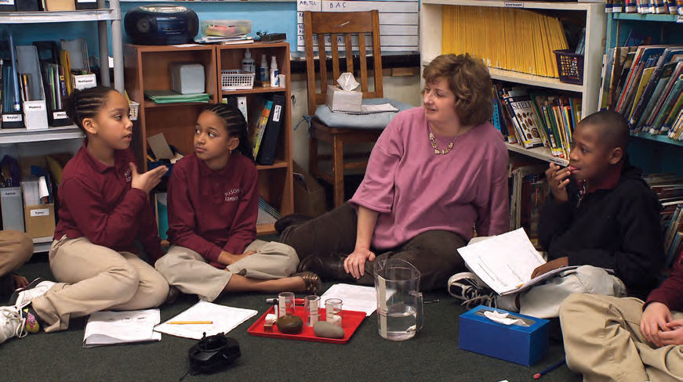
Implications
Discussion

Slide 26
Discussion
Thank you,
Brett Moulding mouldingb@ogdensd.org
Framework and NGSS available in PDF
http:www.nap.edu
Additional information on NGSS
http://www.nextgenscience.org

Slide 27
Below are the directions for Blackboard Collaborate, the software to be used by the online attendees to the meeting on August 28th. Please review the linked page below and download the Collaborate Launcher. Upon installation it will allow your entrance in to any Collaborate room with just one click, as opposed to the four or five that we are used to with the older version.
http://www.wilmu.edu/blackboard/collaborate.aspx
The key to this success is that you get in to the Collaborate room a day or so before the meeting to make sure everything works. If not, the Tech Support number is highlighted in yellow on the Webpage.
You can also attend the meeting via a mobile device if you’d like. The links to the mobile platforms is at the bottom of the Webpage.
Here is the link to the Collaborate room for the meeting: https://wilmu.blackboard.com/webapps/bb-collaborate-bb_bb60/launchSession/guest?uid=5b7067d2-fc3c-4785-812d-1bc78528e288
Thank you,
Dean Davis
Wilmington University

