Slide 1
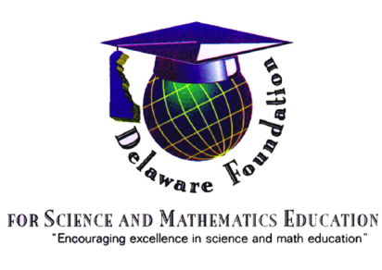
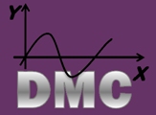
Delaware STEM
Past, Present, & Key to our Future

Slide 2
The Journey Toward System Change Began Nearly 20 Years Ago
In 1995 a survey was conducted across DE and it was found that the predominant form of Science Education was textbook based
As a result, representatives from Red Clay and all Sussex County School Districts attended the National Science Resource Center’s Leadership Academy
After the Leadership Academy the representative group, along with the University of Delaware and Business Sector Partners (specifically DuPont) worked together to write a Local Systemic Change Initiative Grant for $6M

Slide 3
Planning for sustainability
Importantly—in 1995, DuPont and the Coalition formed the Foundation for Science and Mathematics Education (DFSME). The goal was to have DE corporations work cooperatively to pool their grant funds so that funds could be put toward systemic reform efforts in science and mathematics rather than individual district grants that may or may not have large scale impacts on student learning. DFSME was the “Business Sector” 501 (c) 3 that co-wrote the LSCI grant with the Delaware Department of Public Instruction and the University of Delaware at the time.
Jack Collette was the first executive director of DFSME. Ross Armbrecht is the current executive director of DFSME.
Partnership + Planning + Funding =

Slide 4
Goals Of the Delaware Science Coalition
PROVIDE PROFESSIONAL DEVELOPMENT: Establish, support and sustain a system which provides every Coalition teacher with ongoing professional development opportunities to acquire the skills and knowledge needed to implement the Delaware Science Standards.
DEVELOP TEACHER LEADERS: Establish and nurture a network of teachers to lead and sustain improvements in science instruction and learning at the school and district level.
PROVIDE A COHERENT SCIENCE CURRICULUM: Establish a system which embeds science as an integral part of the curriculum for all students and which stimulates and encourages informed curricular decisions.
SUPPORTIVE SCIENCE EDUCATION POLICY: Build a process to ensure that school, district and state policies support systemic improvement of science education aligned with the Delaware Science Standards
BUILD BROAD BASE COMMUNITY SUPPORT: Focus activities of community stakeholders to support systemic improvement of science education as articulated in the Delaware Science Standards.
STUDENT PERFORMANCE: Increase student achievement in science as indicated by state, district and external assessments.

Slide 5
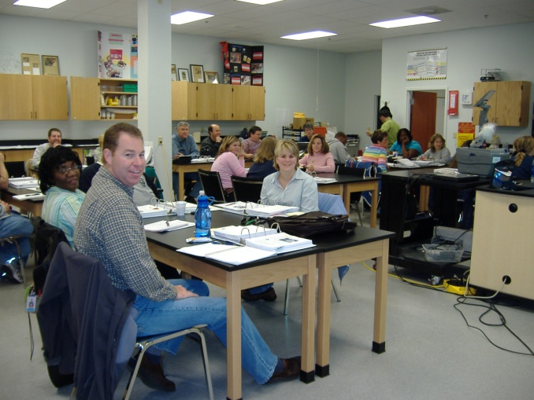
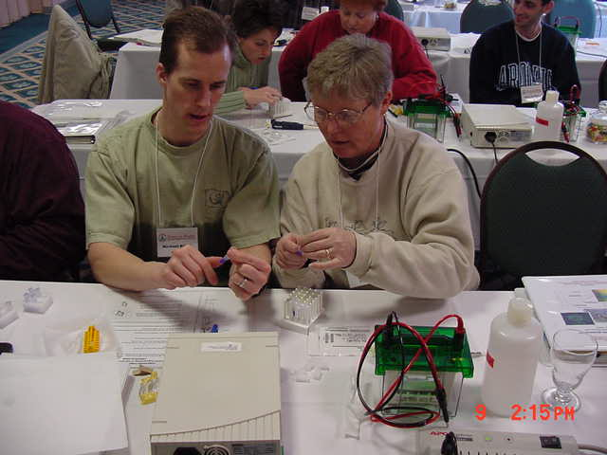
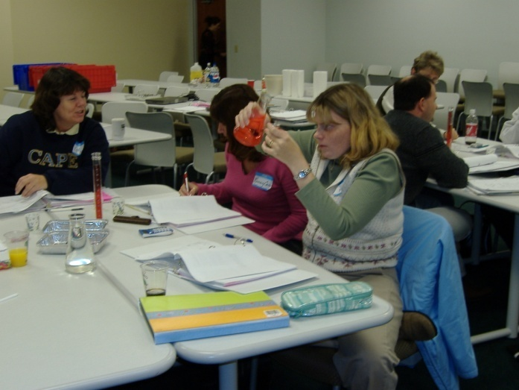
Science Professional Development
Inquiry-based
On-going
Pedagogy, content, and assessment
K-12
Notes:
Professional development is mandatory with all units.

Slide 6
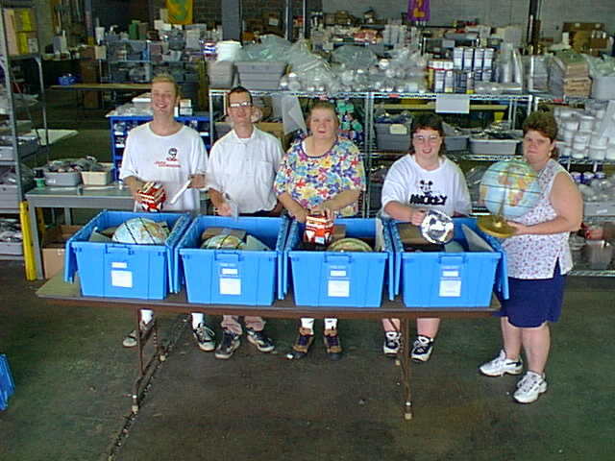
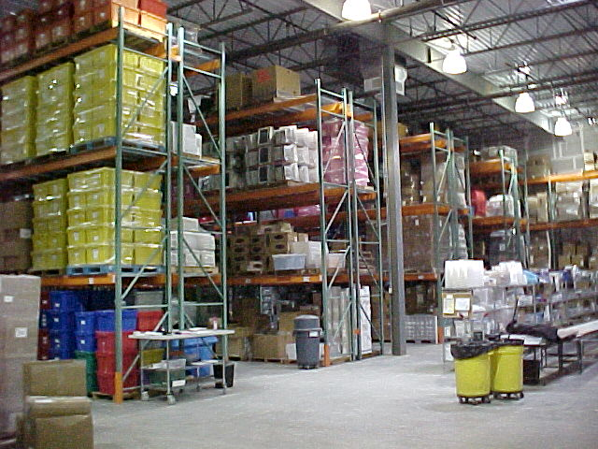
In Addition to High Quality Professional Development…
A materials warehouse has been the backbone of quality instruction, supporting high quality, rigorous science pedagogy in the classroom. No more textbook based read and answer the questions—students now are surrounded by inquiry based hands-on science approaches every year K-10, with ongoing opportunities in Advanced Placement, International Baccalaureate and CTE courses beyond grade 10.
1999
2013

Slide 7
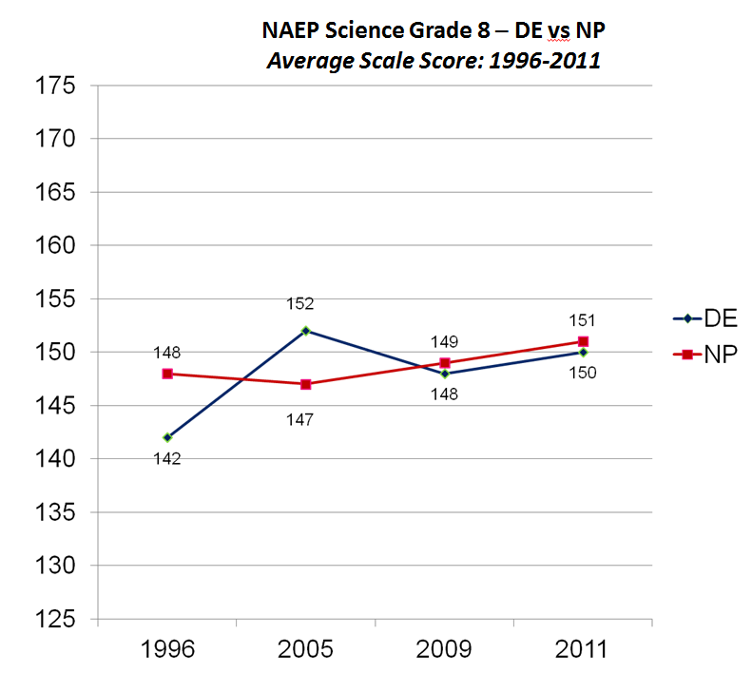
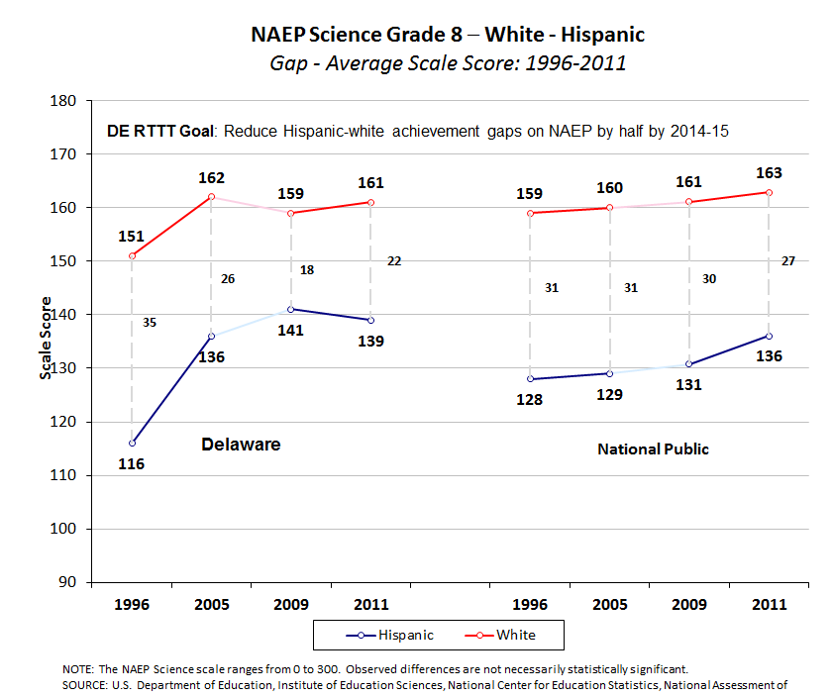
Delaware Makes GREAT Strides—But More Must Be Done

Slide 8
New Initiatives

Slide 9
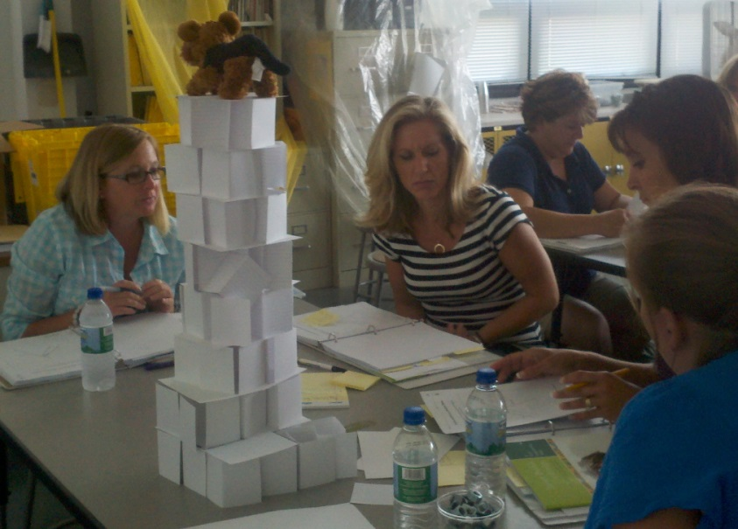
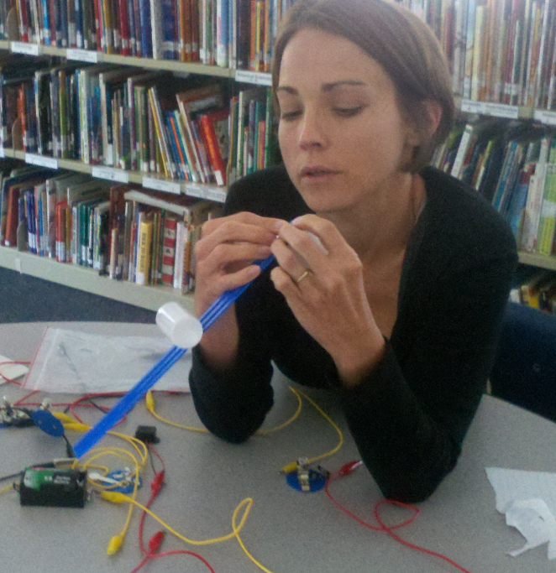
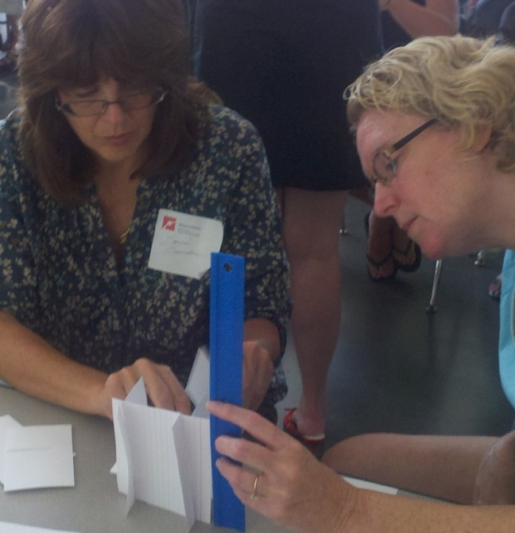
DE STEM Conference—2013

Slide 10
Teachers are on the front lines of education—the success of reform lies heartily in their hands.
High Quality Professional Development Opportunities DE NGSS Teacher Leader Program Aligning Core Curriculum to NGSS Developing Classroom Assessments Identifying areas of Need in current Curriculum Piloting new and/or revised materials Providing District Personnel with Professional Development to spread the knowledge

Slide 11
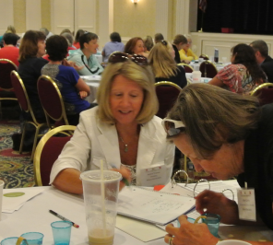
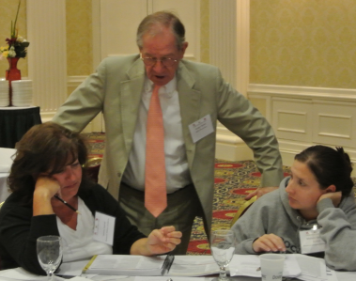
Science Teacher Leader Program--Distributed Leadership at its Best

Slide 12
Science Performances
Communicate Using Models
&
Arguments Supported by Evidence
Construct Explanations and Solve Problems for Cause/Effect Relationships of Phenomena Using Core Ideas
And Patterns
as
Evidence
Ask Questions
Use Mathematics
Plan and Carry Out Investigations Recognize Patterns
Relate Phenomena to Core Ideas
Define Systems Analyze Patterns Analyze Data Evaluate Information
Develop & Use Models
and
Core Ideas to
Make Sense of Phenomena

Slide 13
True STEM While Strongly Embedded in Science Instruction—reaches well beyond the typical Science Classroom walls.

Slide 14
A New Step In Partnerships
In January 2012 Governor Jack Markell Signs Executive Order 15, an act that officially created the Delaware STEM Council. The Council has three goals:
Expand the number of Delaware students who ultimately pursue advanced degrees and careers in STEM fields and broaden the participation of women and minorities in these fields.
Expand the STEM Capable workforce to create, grow and attract STEM related businesses to Delaware.
Increase STEM literacy for all Delaware students including those who pursue non-STEM related careers, but need STEM skills.

Slide 15
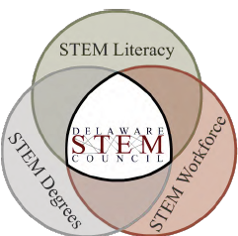
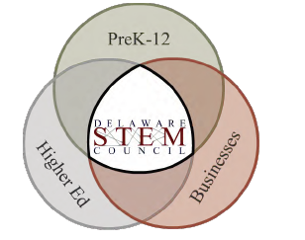
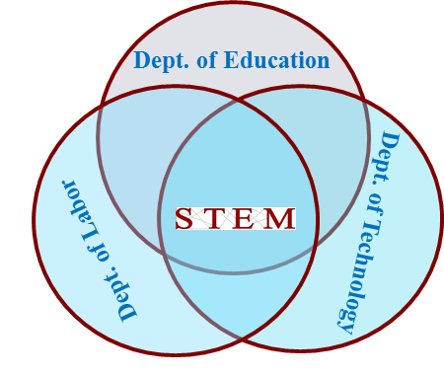
IDEOLOGY

Slide 16
Examples of Catalyze, Connect, Communicate
“JA It’s My Future” program for Delaware middle schoolers. It’s a six-week program slated to begin in the fall that brings STEM professionals into the classroom to introduce students to career paths in STEM-related fields.
STEM Educator Awards, a recognition program for teaching excellence in the fields of science, technology, engineering and math. (2 x $7,500 awards)
S CTE M

Slide 17
S CTE M
The integration of academic theory in applied contexts.
Creating learning trajectories that support the learning of academic science and mathematics and the application of both in technical/real-world situations.
To do this REQUIRES close partnership between
&

Slide 18
Delaware Department of Education has reorganized to develop an office of CTE and STEM.
Primary Goals
To increase numbers of girls and students of special populations in STEM and CTE courses that will participate and ultimately complete relevant pathways.
To offer high interest, high relevancy course curricula that districts can adopt as part of an articulation and infrastructure that is cohesive and coherent across district and school borders.

Slide 19
Multiple entry and exit points for success
ARTICULATION DOES NOT NECESSARILY MEAN SCHOOL TO COLLEGE OR SCHOOL TO WORK—THERE ARE MANY AVENUES TO SUCCESS!!!
HS→ AP courses or Dual Enrollment→ Community Colleges→ University→ Career
Industry
Certification

Slide 20
Delaware STEM: Where Partnership + Planning +(Persistence) and Funding = Success

