Slide 1


IRI/EAG Regional Meeting
August 28, 2014
Wilmington University
Iowa STEM
Iowa’s Shared Mission for Critical Thinkers

Slide 2
What is STEM?
“…an interdisciplinary approach to learning where rigorous academic concepts are coupled with real-world lessons as students apply science, technology, engineering and mathematics in contexts that make connections between school, community, work and the global enterprise enabling the development of STEM literacy and with it the ability to compete in the new economy.”
- Tsupros, N., Kohler, R., & Hallinen, J. (2009). STEM education: A project to identify the missing components. Intermediate Unit 1: Center for STEM Education and Leonard Gelfand Center for Service Learning and Outreach, Carnegie Mellon University, Pennsylvania.

Slide 3
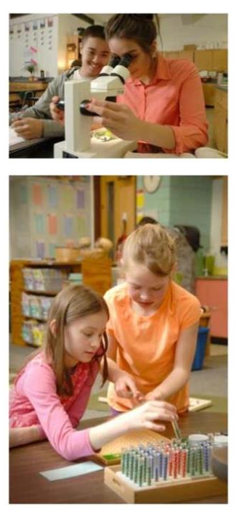
Why STEM?
Economic development advantage
STEM careers pay better, more equitable, recession-proof
STEM jobs growing 4x the rate of other fields
STEM-literacy = quality of life
STEM graduates in demand

Slide 4
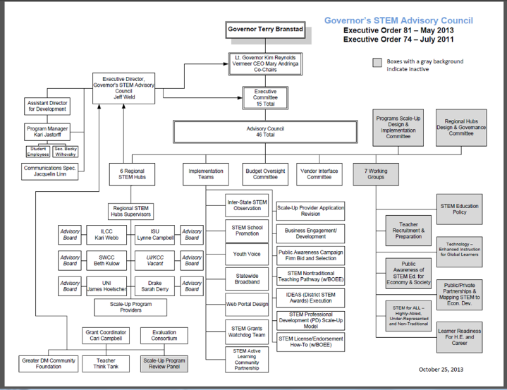
Who is Iowa STEM

Slide 5
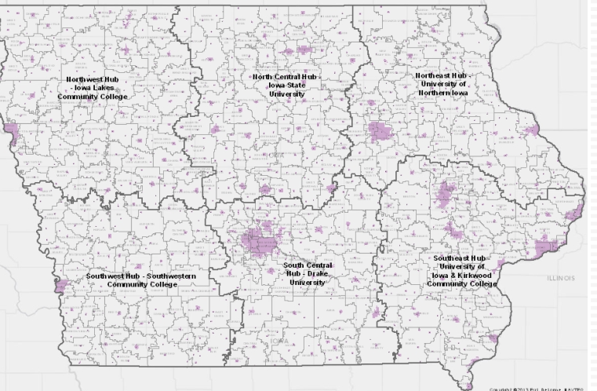











HOW is Iowa STEM

Slide 6

How is Iowa STEM (con’t.)
Scale-Up
Festivals
STEM Endorsement
STEM P.D.
Tchr. Externships
IT Academy
STEM Schools (CAPS)
STEM resources
Networks: Informals, CC’s, Univ.s
Business engagement toolkit
High speed internet for all
Global OECD Test
Public Messaging Campaign

Slide 7








Iowa STEM Scale-Up
Pint Size Science

Slide 8


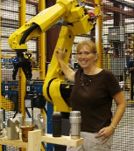

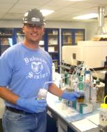



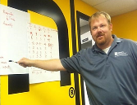
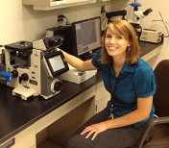


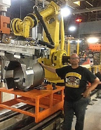
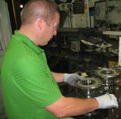
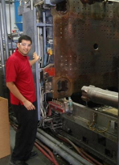
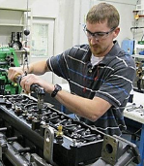

Iowa STEM Externships
Lori Carter, Math and Computer Science teacher, Glenwood Community High School
Andre Echols, Math teacher, Iowa City West High School
Andrew Reinert, Science teacher,
Dubuque Senior High School
Jami Killian, Science teacher,
Davenport Central High School
Ruby Golnick, Clear Lake
Jay Fetzer, North Cedar HS
Taylor Fountain, Engineering teacher,
Muscatine High School
Jack Goedken,
Math & PLTW teacher,
Independence High School
Steve Waldstein, Technology and Engineering teacher,
Armstrong-Ringsted High School
Ricardo Martinez, Math teacher,
Colo-Nesco Learning Center
Dirk Homewood, Math teacher,
Cedar Falls High School

Slide 9
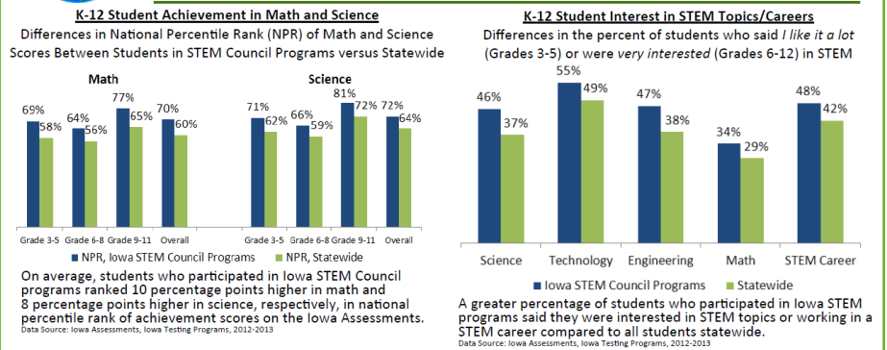
Effect of Iowa STEM

Slide 10

Iowa STEM: Engagement Points
IT Academy
Externship
Scale-Up
CAPS model
STEM Endorsmnt.
Committee-
- Ag Sci
- Comp Sci
- Arts n’ STEM
- Volunteerism
Board or Council member

Slide 11
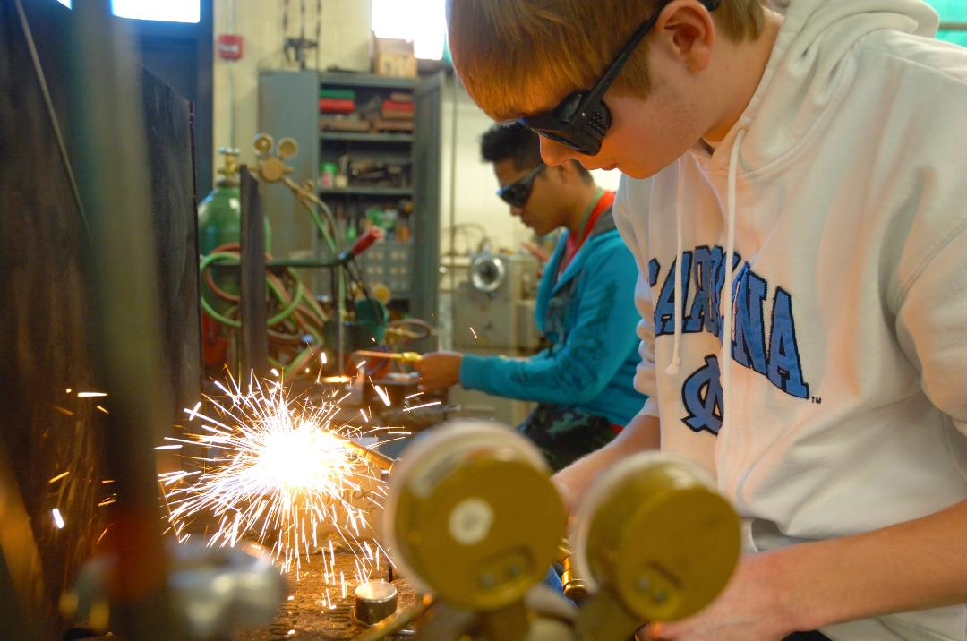
Contact: Info@IowaSTEM.gov
Iowa’s STEM Edu-nomic Development Mission

