Slide 1




The SC STEM
Ecosystem
Founding Partners
Notes:
In Attendance:
Paula Gregg Sheila Myers-Stratford
Jerry Marshall Rebecca Hartley
Cheryl Smith*
Donn Griffith*
Nan Dempsey
Terry Pruitt*
Barbara Allen
Alice Gilchrist
Lori Smith*
Tom Peters
Linda Payne
Zelda Waymer*
Lynn Mack*
Jenna Hallman
Victoria Cord
Kris Frady
Jessica Sharp
Jeff Lee
Stephanie Pwirtz
Donna Foster*
Walt Tobin* *denoted board member

Slide 2
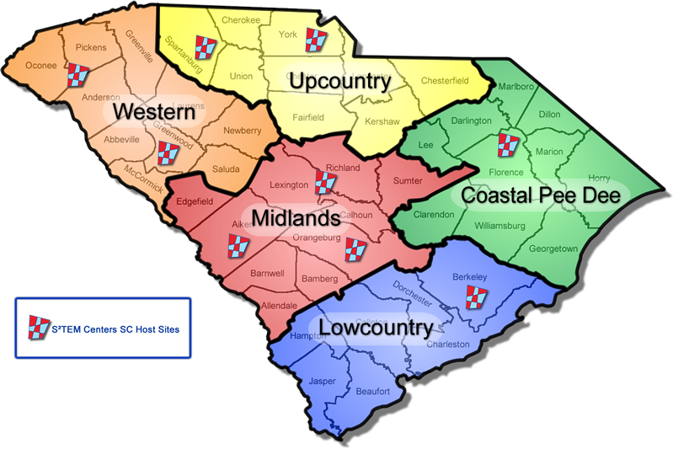

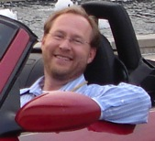

South Carolina’s statewide network for STEM education since 1993.
Dr. Tom Peters
Executive Director
tpeters@clemson.edu
864-656-1863

Slide 3
STEM, STEAM, STEMS, STREAM, ESTEEM? Who cares?
There is little agreement in the community of practice on naming what many see as a movement. In SC, we use STEAM, STE(A)M and STEM and the Arts interchangeably to mean learning that thoughtfully integrates the practices and habits of mind of science, technology, engineering, mathematics and the fine and applied arts.

Slide 4
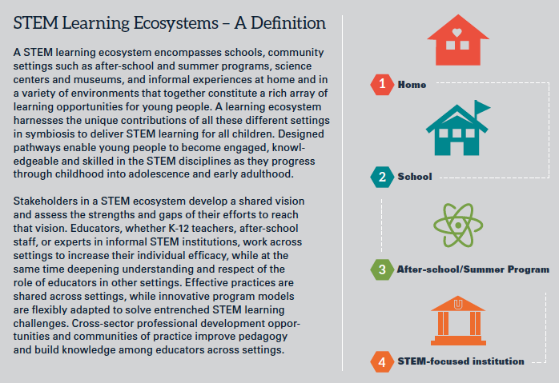
A STEM Ecosystem?
Report from the Field, Traphagen & Traill, 2014
Unique Contributions
Designed pathways
Shared vision
Cross-sector collaboration
Notes:
Noyce Foundation commissioned report.

Slide 5
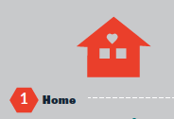

What do we know about SC homes?
Unique Contributions
No one has more influence on children’s career aspirations
Designed Pathways
It’s a ball of confusion
Cross Sector Collaboration
On the rise in SC – Cradle to Career movement
Shared Vision
Uncommon concern with academic standards
General I. Z. Ation
Notes:
According to ACT ~29% of SC students taking ACT expressed interest in STEM (above national avg of 23%)
~47% have no interest.
Keeping in mind these are ACT tested kids…therefore they are anticipating plans for post-secondary education.
Advanced manufacturing companies in SC cannot find enough candidates for their workforce.
Memories of mill work??

Slide 6

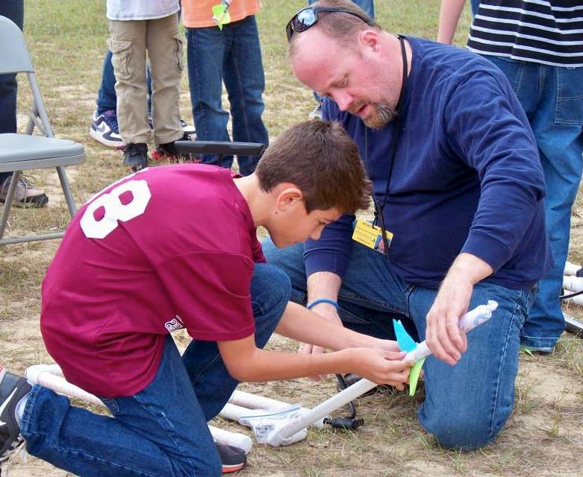




What are we doing about SC homes?
Charleston STEM fest
Notes:
Building the STEM brand

Slide 7





South Carolina’s One Stop Discovery Site for STEM Learning and Resources
SCIENCE/TECHNOLOGY/ENGINEERING/MATHEMATICS
http://www.stemlinx.org/
Notes:
Making STEM accessible.

Slide 8
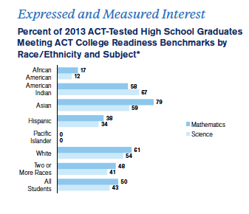
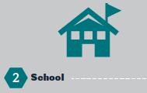
What do we know about SC schools?
Unique Contributions
The rise of the STEM school
Academic standards – Good, Bad and Ugly
Designed Pathways
Elementary science is DOA
Mathematics still functions to weed out rather than build talent
Cross Sector Collaboration
“Partners du jour” culture giving way to lasting collaborations
Serious equity issues
Shared Vision
SDE is MIA
Uncommon concern with academic standards
General I. Z. Ation
Notes:
Outcomes are not terrific…and it is no surprise.

Slide 9
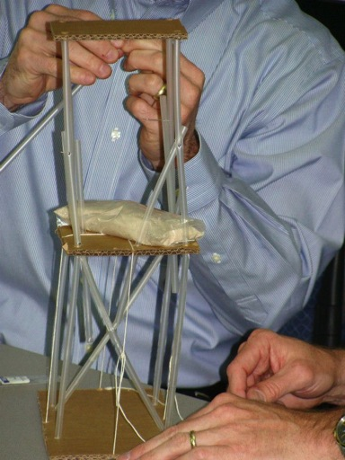
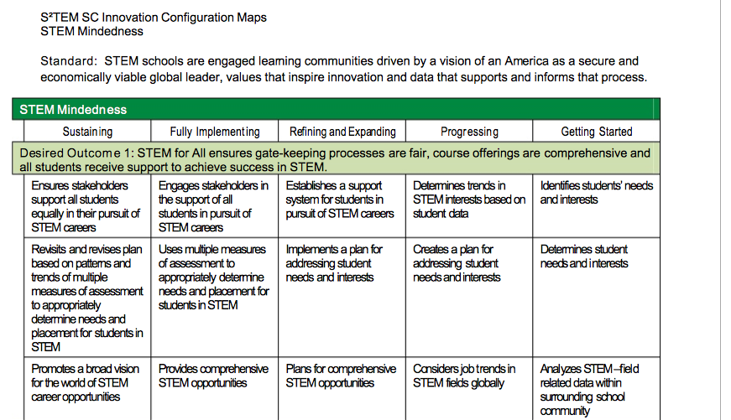
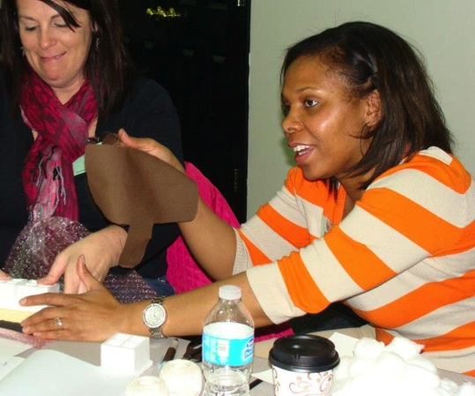
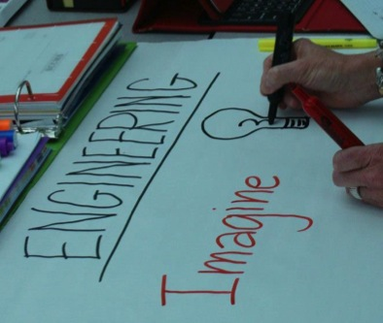
What are we doing about SC schools?
iSTEM
Engineering
Leadership
STEM
Schools
Support
Pilot

Slide 10

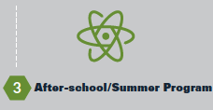
What do we know about SC After-school?
Unique Contributions
Freedom to innovate
Designed Pathways
Serious capacity issues
Cross Sector Collaboration
On the rise in SC
Shared Vision
Building at the national level – Noyce/Mott
In SC, we use after-school and out-of-school-time interchangeable to mean learning taking place outside of a traditional school day time period or school setting.
General I. Z. Ation

Slide 11

What are we doing about SC After-school?
And a bunch of partnering projects statewide and local.
Notes:
Digital badging.

Slide 12

What do we know about SC STEM-focused institutions?
Unique Contributions
Make STEM meaningful in economy and career opportunities
Designed Pathways
Yes, for STEM majors…then there’s everyone else
Cross Sector Collaboration
Everyone has a STEM outreach program or two or more
Shared Vision
34 IHE’s prepare future STEM teachers. ‘Nuff said.
General I. Z. Ation
Notes:
Our collaboration with CUCWD

Slide 13
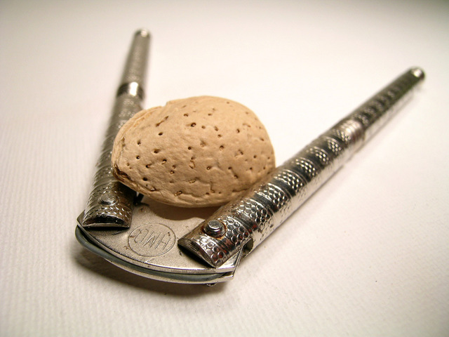
What are we doing about SC STEM-focused institutions?
Notes:
Finding ways to partner but its not systemic.

Slide 14



www.sccoalition.org
Tom Peters, Ed.D.
Executive Director
South Carolina’s Coalition
for Mathematics & Science
tpeters@clemson.edu
864-656-1863
Nan Dempsey, Ed.D.
Director
Upstate SC STEM Collaborative
dempseyn@upstatesc.org
(864) 596-8452
Darren Prevost
Director
Lowcountry SC STEM Collaborative
prevostd@lcrsc.org
(843) 793-1335
www.s2temsc.org
www.stemlinx.org
Notes:
To carry the conversation forward…

